Slide 1

KLE Society’s
A Course Project On
DATA MINING AND ANALYSIS
PREDICT THE EXPECTED ANSWER
Submitted by
Ajinkya Thorawat

Slide 2
PROBLEM STATEMENT
To predict associated intent for each questions related to drugs.
questions about drugs correct intent
identification of correct classification of questions

Slide 3
INTRODUCTION
POSOS challenge
Millions of questions are asked every year about drugs . There is a limited number of query types but the same question could be asked in many ways.
Understanding what information people expect when asking a question is a great challenge.

Slide 4
DATA DESCRIPTION
input_train.csv : Columns: 2 Rows: 8028
input_test.csv : Columns: 2 Rows: 2035
Attributes: ID, question
ID | question
0 | Atenolol, what is it?
1 | I just learned that I am enceinte
2 | Is there a form adapted to child
3 | I take Trinordiol and at the end
ID | question
8028 | Homeopathy autism-vaccine-
8021 | What topically applied to atopic
8022 | Cyst treatment with Diane 35?
8023 | I suffer from venous insufficien

Slide 5
DATA DESCRIPTION
challenge_output_data_training_file_predict_the_expected_answer.csv
Rows: 8028 Columns: 2
Attributes: ID, Intention
 | ID;intention
0 | 0;28
1 | 1;31
2 | 2;28
3 | 3;44

Slide 6
DATA PRE-PROCESSING
Lower casing
Removal of punctuations
Removal of stop words
Lemmatization
Vectorization

Slide 7
MODEL BUILDING
DECISION TREE
RANDOM FOREST
3. LINEAR SVC
4. STOCHASTIC GRADIENT DESCENT

Slide 8
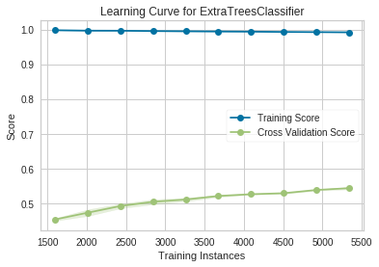
MODEL BUILDING
1. DECISION TREE:
- Decision tree is a popular classifier which is simple and easy to implement.
- High dimensional data can be handled. It produces results which are easier to read and interpret.
Accuracy is : 0.5933

Slide 9
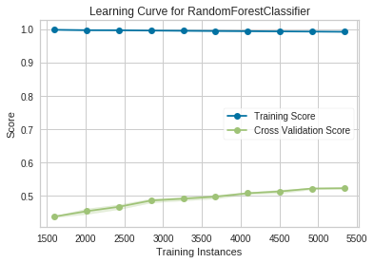
MODEL BUILDING
2.RANDOM FOREST:
- Random forests or random decision forests are an ensemble learning method for classification, regression and other tasks, that operate by constructing a multitude of decision trees at training time and outputting the class that is the mode of the classes (classification) or mean prediction (regression) of the individual trees.
Accuracy is : 0.5778

Slide 10
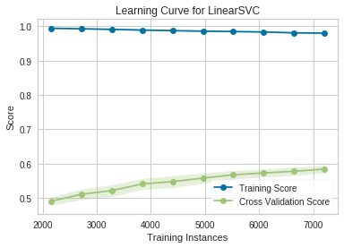
MODEL BUILDING
3. LINEAR SVC:
The objective of a Linear SVC (Support Vector Classifier) is to fit to the data you provide, returning a "best fit" hyper plane that divides, or categorizes, your data.
Accuracy is : 0.6058

Slide 11
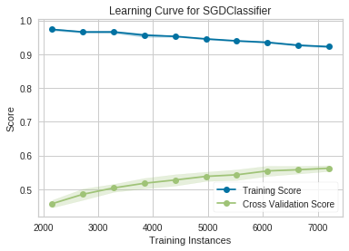
MODEL BUILDING
4. STOCHASTIC GRADIENT DESCENT
- SGD is indeed a technique that is used to find the minima of a function
- SGD Classifier is a linear classifier (by default in sklearn it is a linear SVM)
Accuracy is : 0.6083

Slide 12
PERFORMANCE EVALUATION
MODEL | ACCURACY
Sophisticated Gradient Descent | 0.6083
Linear SVC | 0.6058
Random Forest | 0.5778
Decision Tree | 0.5933

Slide 13
LEADER-BOARD RANKING
According to leader board scores, we stand in 26th position among 37 participants. Our accuracy is 0.6064

Slide 14
CONCLUSION
The problem that we addressed is POSOS challenge in which we have to find the appropriate intent number of the questions given, to which they belong to.
Among all the models used, the accuracy of Sophisticated Gradient Descent is more i.e., 0.6083. So, we preferred to use this model.
As the model’s accuracy is not more than 90%, we are again going with KDD process to get better result.

